Slide 1
What Dialect La
By: Jashwant and Yi Da

Slide 2
Project Objectives
English Dialects: A particular form of English that is peculiar to a specific region or social group (local slang)
Classify English Dialects
Knowing the ethnicity of a person can help sidestep cultural taboos or utilised for cultural references during conversation
Translate an English Dialect to another
Allows for someone to understand another dialect, specifically the nuances

Slide 3
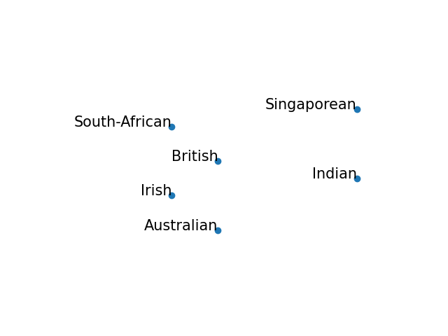
Data Collection
Collected
180 sentences with dialects from youtube street interviews
30 standard English sentences from instruction manuals and research papers (Standard/Formal English)
Notes:
Data was sufficient as the base to investigating the problem

Slide 4
Data Examples
Irish | : | I'm feeling a bit peckish; could you pass the Tayto crisps?
British | : | Skinny chap with a beard in a de-mob suit, and that knife up there in his kitbag.
South-African | : | I'll come visit you now-now, just finishing up some work.
Australian | : | We are having some mates over for a barbie sarvo, you should come!
Indian | : | The teacher has gone out of station, so this period is free.
Singaporean | : | I think he blur like sotong, go all the way there for nothing.
Notes:
Some similarities between certain dialects but we are pretty sure that won’t cause us any problems

Slide 5
Dialect Classification (Structure)
Prompt for classification
(Zero Shot, Few Shot, Chain of thought)
Compare and calculate accuracy
GPT-4
Output:
Dialect Class
Sentence :
He's a few roo's loose in the top paddock

Slide 6
Prompt for classification, including available classes
Sentence Database:
He's a few roo's loose in the top paddock
Compare and calculate accuracy
GPT-4
Output:
Dialect Class

Slide 7
Dialect Classification (Results)
Zero-Shot Classification
Chain of Thought Prompting
 | Std | Brt | Sgp | Ind | Aus | Saf | Irs
Std | 30 | 0 | 0 | 0 | 0 | 0 | 0
Brt | 2 | 26 | 0 | 0 | 0 | 0 | 1
Sgp | 4 | 1 | 22 | 2 | 0 | 1 | 0
Ind | 3 | 1 | 2 | 24 | 0 | 0 | 0
Aus | 0 | 1 | 0 | 0 | 29 | 0 | 0
Saf | 7 | 5 | 1 | 1 | 3 | 13 | 0
Irs | 6 | 7 | 1 | 0 | 1 | 0 | 14
 | Std | Brt | Sgp | Ind | Aus | Saf | Irs
Std | 30 | 0 | 0 | 0 | 0 | 0 | 0
Brt | 3 | 26 | 0 | 0 | 0 | 0 | 1
Sgp | 8 | 0 | 19 | 2 | 0 | 1 | 0
Ind | 3 | 0 | 0 | 27 | 0 | 0 | 0
Aus | 0 | 1 | 0 | 0 | 29 | 0 | 0
Saf | 9 | 4 | 1 | 1 | 1 | 14 | 0
Irs | 8 | 7 | 0 | 0 | 1 | 0 | 14
Accuracy: 75.24%
Accuracy: 75.71%

Slide 8
Dialect Classification (What went wrong)
- Not all sentences are part of a single dialect
Example: Let’s have a wee chat over a cup of coffee, shall we?
Irish in our database, Scottish in reality, classified as British
- Some sentences are hard to tag a dialect to
Example: That new restaurant is really good, you know?
Singaporean in our database, but not distinct enough

Slide 9
Data Reprocessing
Double label the data
Example: Let’s have a wee chat over a cup of coffee, shall we?
Labelled as both Irish and British
Example: That new restaurant is really good, you know?
Labelled as both Singaporean and Standard English
Example: This watchman keep shouting something or the other, he never keeps quiet.
Labelled only as Indian
Considered correct as long as one of the two classes are predicted right

Slide 10
Dialect Classification (New results)
Revised accuracy: 88.57%
Issues
Still mixes up Irish and British sentences
(Linguistically very similar)
Less willing to make assumptions
(More likely to treat a sentence as standard English than classifying)
Original Classification | Revised Accuracy (%) | Original ZS Accuracy (%)
Standard | 100 | 100
British | 93.3 | 86.7
Singaporean | 83.3 | 73.3
Indian | 90 | 80
Australian | 96.7 | 96.7
South African | 80 | 43.3
Irish | 76.7 | 46.7

Slide 11
Dialect Translation (Structure)
Prompt for Translation
Dialect : Singaporean
(Zero Shot, Few Shot, Chain of thought)
Provide a rating
aka
Mean opinion score
GPT-4
Output:
Translated sentence
Sentence :
I was thinking of going to the beach, just now, if the weather holds up.

Slide 12
Prompt for Translation
Dialect : Singaporean
(Zero Shot, Few Shot, Chain of thought)
Provide a rating
aka
Mean opinion score
GPT-4
Output:
Translated sentence
Sentence :
I was thinking of going to the beach, just now, if the weather holds up.

Slide 13
Prompt for translation, including target dialect
Sentence Database:
I was thinking of going to the beach, just now, if the weather holds up.
Mean Opinion Score for comparison
GPT-4
Output:
Translated sentence

Slide 14
Dialect Translation (Quantitative)
Scored only Indian and Singaporean translations
30 sentences each
Used mean opinion score and this is our rubrics
Score ranges from 1 to 5,
With 5 being the best and the base score being 1
Points | +0 | +1 | +2
Original meaning preserved | Meaning of original sentence was lost | Some parts of the meaning has been altered but is largely correct. | The meaning of the sentence got preserved entirely.
Sentence structure and vocabulary of the target dialect | The generated sentence does not contain any aspects of the target dialect. | Some aspects of the target dialect were shown but there were either grammatical or sentence structural mistakes | The generated sentence has the sentence structure and some vocabulary from the target dialect.
Zero-Shot Temp: 1, Top P: 0.5 Indian MOS: 3.47 Singaporean MOS: 3.55
Zero-Shot Temp: 0 Indian MOS: 3.9 Singaporean MOS: 3.98
Chain of Thought Temp: 1, Top P: 0.5 Indian MOS: 3.75
Singaporean MOS: 3.88
Chain of Thought Temp: 0 Indian MOS: 4.45 Singaporean MOS: 4.2

Slide 15
Dialect Translation (Qualitative)
 | Singaporean Examples | Indian Examples
Good Sentence | Don't bluff, we know you never buy one. (Chumma don't act, we know you didn't buy) | Thank God, it's just a light rain today, only a bit of drizzle (It's a soft day, thank God, just a light drizzle.)
Good Sentence | I come see you later, just settling some work. (I'll come visit you now-now, just finishing up some work.) | Arre, you're so competitive yaar, always needing to be first in everything. (Eh, you very kiasu leh, always must be first in everything)
Bad Sentence | That movie was shiok lah? (That movie was too good, hey?) | That rugby match was an absolute blast last night. (That rugby match was an absolute jol last night.)
Comments | Specific lingo was used was effective even without the use of dialect specific vocabulary. The main issue is the poor use of ‘lah/la’ and ‘shiok’, missing the nuanced meaning of those work | The translation was mostly accurate and for sentences that did not necessarily have any need for an Indian dialect were also translated correctly, bad translation were either overusing yaar, and only. Some translation were not close to the Indian dialect.

Slide 16
Discussions & Learnings
Dialects are hard to define as classes
People can pick up dialect traits from multiple places (See British and Irish)
It is best to approach it as a multi-label classification problem
Potentially can attempt multi-class translation
Made the classification open-ended
Unrestricted classification for the model
Dialects with less speakers are not as good
Using GPT builder’s knowledge base to supplement extra knowledge

Slide 17
Thank you for listening!

Slide 18
Classifying the Generator outputs
Putting the outputs of the zero-shot temp=0 translator into the zero-shot classifier to get the accuracy: 55%
Major issues:
Irish, British and Australian tended to get classified as each other
Translator GPT really tried to shove words where it didn’t make sense and that confused the classifier GPT

Slide 19
Other Translation examples
Singaporean | Indian
No need to wait lah, I let my sayang wife Betty and my special daughter Emily do the revealing one. () | That film was brilliant, indeed it was.
Born and raised with a simple hat and a cup of mild drink, and a job in the steel industry. | Shall we have a small talk over a cup of chai?
Everytime he give one missed call, I think he never top up his phone one. | You're going to the cricket match, isn't it?
It's the Christmas gift lah, best thing to open on Sunday one. | We can go eat at the food court later.

